Slide 1
“I Ceased Not To Warn Every One Night And Day With Tears” (KJV)
Acts 20:31

Slide 2
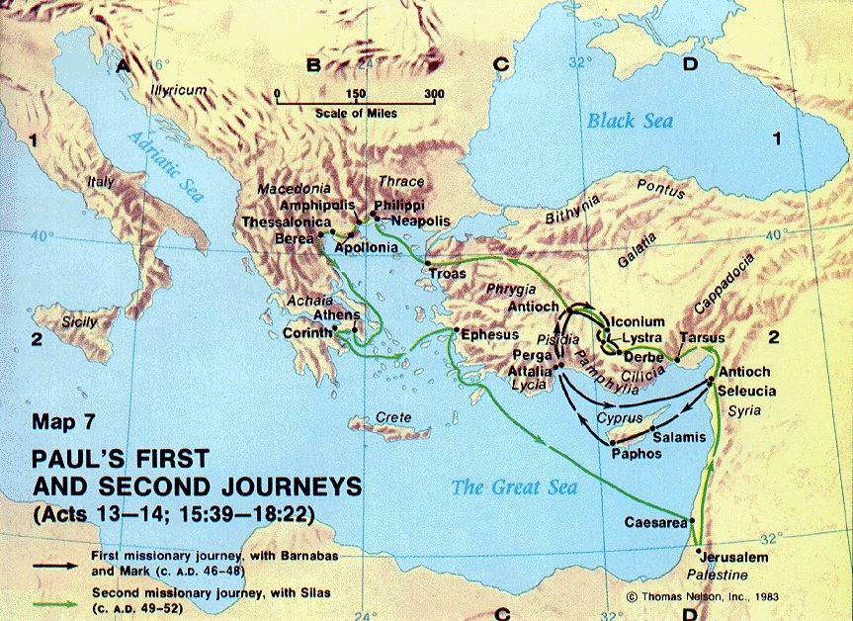
The Church In Ephesus – Second Journey
Troas to Province of
Macedonia
Province Achaia
Provinces
Phrygia and Galatia
Derbe and Lystra
Provinces
Syria and Cilicia
Ephesus
Acts 18:18-20
“I will return”
18:21
Aquila and Priscilla left in Ephesus
18:24-28

Slide 3
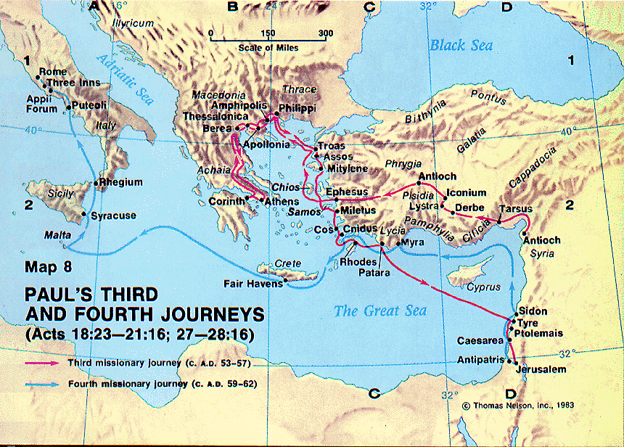
Paul’s Return To Ephesus – Third Journey
Timothy left at Ephesus
(1 Timothy. 1:3)
Preached 3 years
(Acts 20:31) 54 AD
Paul returns from Corinth …
Begins
Meets with the Ephesian elders in Miletus.
(Acts 20:17ff)

Slide 4
Warnings
Matthew 24:4, “Take heed that no man lead you astray.”
Mark 13:33, “Take ye heed, watch and pray.”
Matthew 16:6, “Take heed and beware of the leaven of the Pharisees and Sadducees.”
1 Corinthians 3:10, “But let each man take heed how he buildeth thereon.”

Slide 5
Warnings
1 Timothy 4:16, “Take heed to thyself, and to thy teaching.”
Luke 8:18, “Take heed therefore how ye hear.”
Mark 4:24, “Take heed what ye hear.”
Matthew 6:1, “Take heed that ye do not your righteousness before men.”
Luke 12:15, “Take heed, and keep yourselves from all covetousness.”

Slide 6
Warnings
Acts 20:28, “Take heed unto yourselves, and to all the flock, in which the Holy Spirit hath made you bishops, to feed the church of the Lord which he purchased with his own blood.”

Slide 7
Paul And His Work
Paul’s courage. Acts 20:20, 27;
cf. Ezekiel 3:18
Anticipated afflictions that awaited him. Acts 20:22-25

Slide 8
Persistence
“Ceased not to admonish everyone night and day …” Acts 20:31
Admonish – “nouthetoon; to place before the mind; setting the danger and duty of each individual before him.” (Barnes)

Slide 9
Persistence
Three months in the synagogue facing opposition of the Jews. Acts 19:8
Two years, daily in the school of Tyrannus. Acts 19:9-10
Total of three years “so that all they that dwelt in Asia heard the word of the Lord, both Jews and Greeks.” Acts 19:10

Slide 10
Persistence
Taught publicly and from house to house. Acts 20:20
  Success: Acts 19:18-20
  Failure: Acts 19:23-31

Slide 11
Intensity
“Ceased not to admonish everyone night and day with tears.” Acts 20:31; cf. 19
At Ephesus, tears caused by:
1. Ignorance. Acts 19:2
2. Blasphemy. Acts 19:9
3. Idolatry. Acts 19:28

Slide 12
Intensity
“Ceased not to admonish everyone night and day with tears.” Acts 20:31; cf. 19
Examples:
1. Jesus. Luke 19:41
2. Samuel. 1 Samuel 15
3. Ezra. 10:1
4. Paul. Romans 9:1ff; 10:1

Slide 13
Substance
“Grievous wolves shall enter in among you, not sparing the flock.” Acts 20:29; cf. Matthew 10:16; Matthew 7:15
“And from among your own selves shall men arise, speaking perverse things, to draw away the disciples after them.” Acts 20:30

Slide 14
Substance
Historically true.
Israel.
Danger from without. Deuteronomy 7:1-4
Danger from within. Jeremiah 2:32;
6:10-16; Zephaniah 3
Lord’s church.
Danger from without. Acts 14
Danger from within. Acts 15; Galatians 2

Slide 15
Objects
Elders
“Called to him the elders of the church …” Acts 20:17
“Take heed to yourselves and to the flock …” Acts 20:28
“Wherefore, watch YE ...” Acts 20:31

Slide 16
Objects
Elders.
Watch: error, false doctrine, and corruptions of the “faith once delivered” (Jude 3).
  Titus 1:9, “holding to the faithful word which is according to the teaching, that he may be able to exhort in the sound doctrine, and to convict the gainsayers.”
  1 Timothy 3:2, “apt to teach …”

Slide 17
Objects
Elders care for something that they do not own.
cf. John 10:11
“The church of the Lord, which he purchased with his own blood …” Acts 20:28;
1 Peter 1:18-19
They are to “feed” or “tend” or “pastor.”
1 Peter 5:2
They “watch for … souls.” Hebrews 13:17
Thus, they are stewards. Titus 1:7, “For the bishop must be blameless, as God’s steward …”
As such “they shall give account.” Hebrews 13:17

Slide 18
To Heed The Warning
Acts 20:32, “And now I commend you to God, and to the word of his grace, which is able to build (you) up, and to give (you) the inheritance among all them that are sanctified.”

Slide 19
The Value Of Warnings
1 Corinthians 10:12, “Wherefore let him that thinketh he standeth take heed lest he fall.”
Romans 8:13, “for if ye live after the flesh, ye must die”
1 Corinthians 16:13, “Watch ye, stand fast in the faith, quit you like men, be strong.”
Galatians 6:7, “Be not deceived; God is not mocked: for whatsoever a man soweth, that shall he also reap.”
Ephesians 6:11, “Put on the whole armor of God, that ye may be able to stand against the wiles of the devil.”

Slide 20
“I ceased not to warn every one night and day with tears” Acts 20:31 (KJV)
Persistence
Intensity
Substance
“grievous wolves shall enter in among you”
Acts 20:29
Objects
Solution
Acts 20:32, “And now I commend you to God, and to the word of his grace, which is able to build (you) up, and to give (you) the inheritance among all them that are sanctified.”

